Slide 1
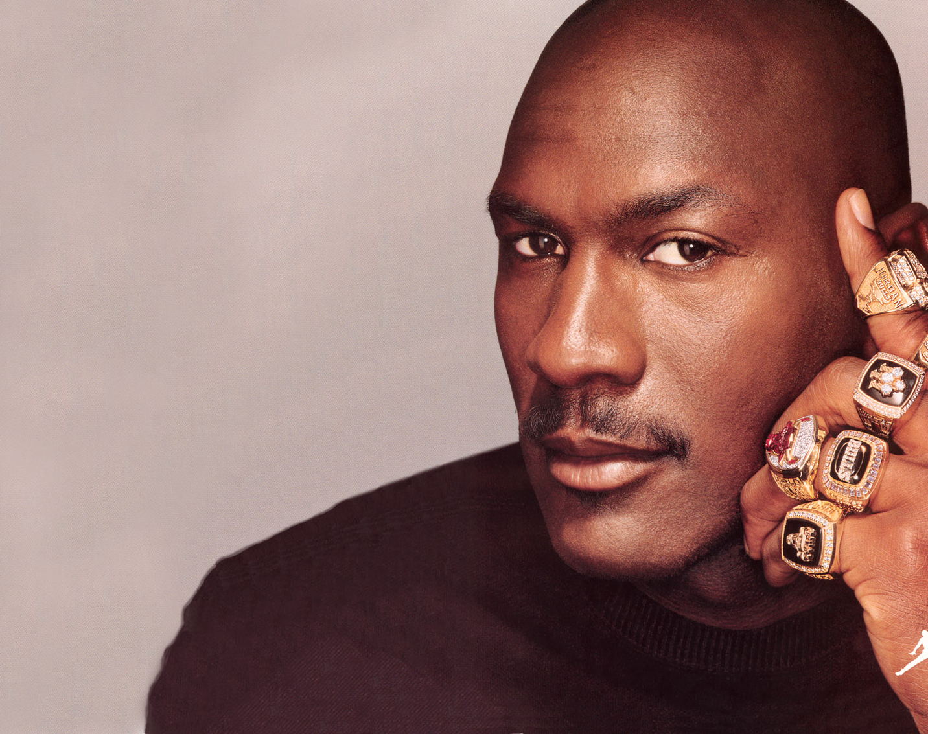



Writing Cybersecurity Policies: You Don't Have to be Michael Jordan
Frank McGovern
FrankMcG.com
@FrankMcG
LinkedIn.com/in/FrankMcGovern

Slide 2


Photos and Recording Allowed
FrankMcG.com
@FrankMcG
LinkedIn.com/in/FrankMcGovern

Slide 3
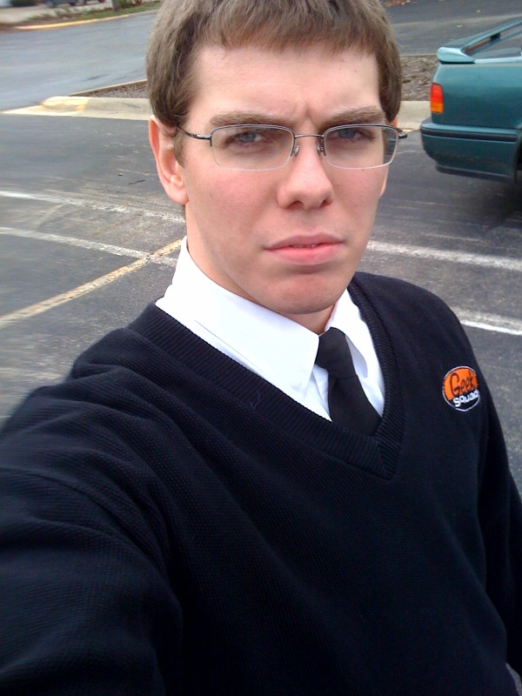
whoami
Frank McGovern – Chicago, IL
CISSP, CISM, CSM
Former USMC 0231
Walsh Construction: 2010 to 2020
Help Desk -> Infrastructure Engineer -> Network Security Engineer -> Information Security Engineer -> Sr. Information Security Engineer
StoneX: 2020 to Present
Cybersecurity Architect
Blue Team Con Founder
FrankMcG.com
@FrankMcG
LinkedIn.com/in/FrankMcGovern

Slide 4

Why?
Documentation.
Documentation.
Documentation.
FrankMcG.com
@FrankMcG
LinkedIn.com/in/FrankMcGovern
Notes:
Small shop is more at risk of someone leaving with all knowledge.
Court System requires due diligence and due care.

Slide 5
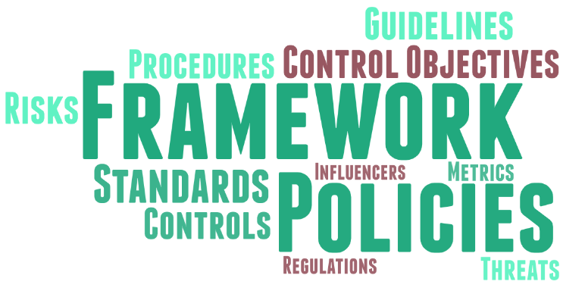
Terminology
FrankMcG.com
@FrankMcG
LinkedIn.com/in/FrankMcGovern

Slide 6
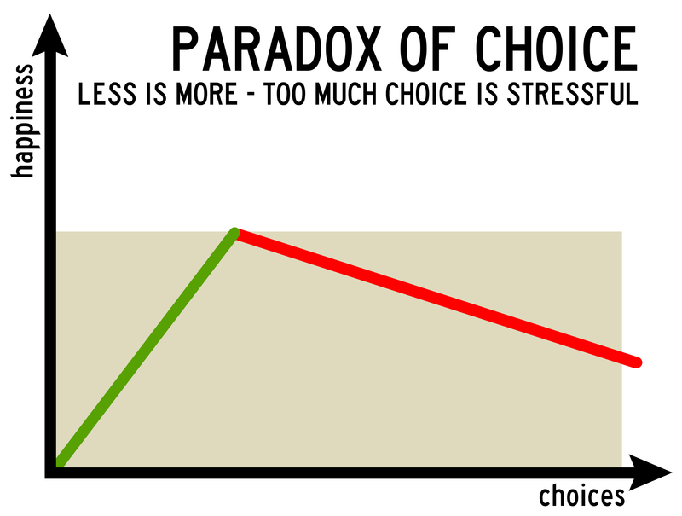
Analysis Paralysis
FrankMcG.com
@FrankMcG
LinkedIn.com/in/FrankMcGovern
Notes:
Woah…let’s slow down.
Analysis paralysis describes an individual or group process when overanalyzing or overthinking a situation can cause forward motion or decision-making to become "paralyzed", meaning that no solution or course of action is decided upon.

Slide 7
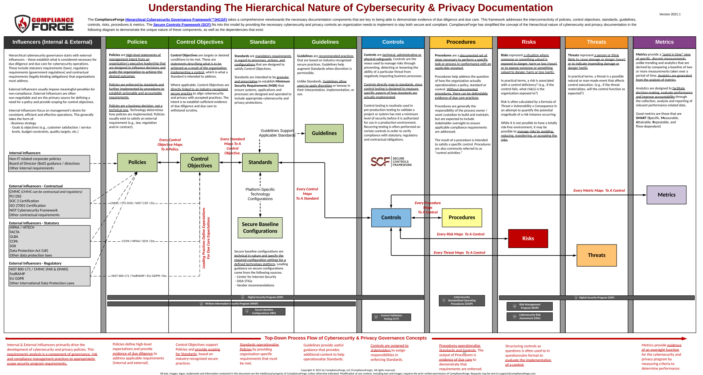
FrankMcG.com
@FrankMcG
LinkedIn.com/in/FrankMcGovern
Notes:
Tweet

Slide 8
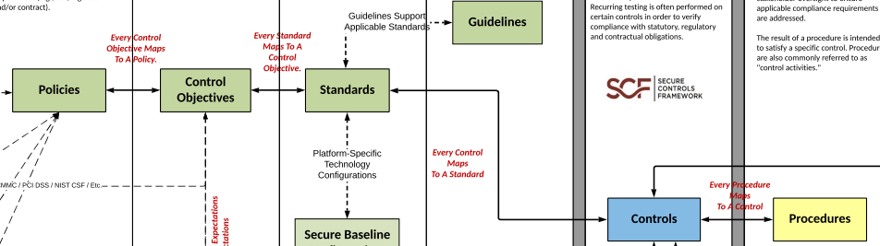
The Basics
FrankMcG.com
@FrankMcG
LinkedIn.com/in/FrankMcGovern
Notes:
Policies – Statement of Expectation or “Management’s Intent” (high-level)
Control Objectives – Targets or Desired Conditions (What do you want to achieve?)
Standards – Mandatory Requirements (granular and prescriptive) – MSR (Minimum Security Requirement)
Guidelines – Best Practices (discretionary)
Controls – Technical, Administrative, or Physical Safeguard
Procedures – Formal method of doing something

Slide 9
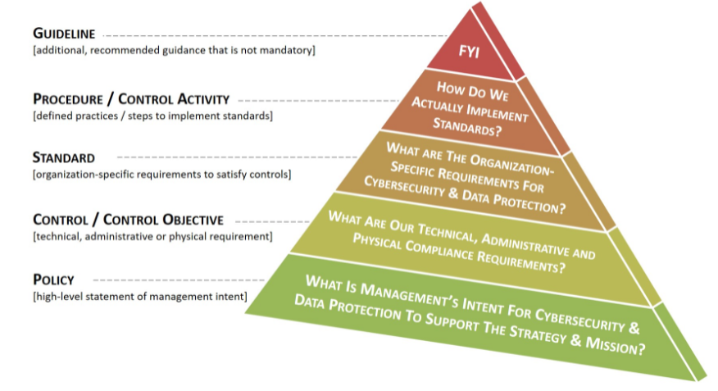
FrankMcG.com
@FrankMcG
LinkedIn.com/in/FrankMcGovern
Notes:
Policies – Statement of Expectation or “Management’s Intent” (high-level)
Control Objectives – Targets or Desired Conditions (What do you want to achieve?)
Standards – Mandatory Requirements (granular and prescriptive) – MSR (Minimum Security Requirement)
Guidelines – Best Practices (discretionary)
Controls – Technical, Administrative, or Physical Safeguard
Procedures – Formal method of doing something

Slide 10
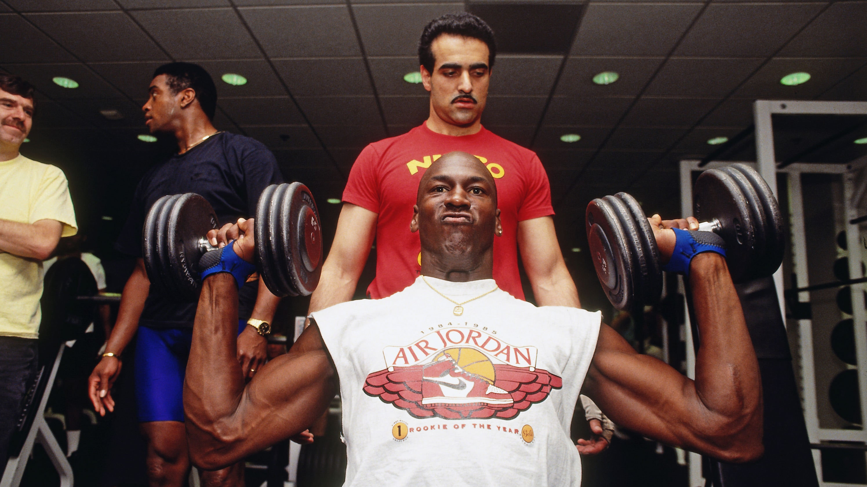
FrankMcG.com
@FrankMcG
LinkedIn.com/in/FrankMcGovern
Notes:
While filming Space Jam from 7am to 7pm, he still put in five-hours of practice a day. He used the two-hour break he got every day to work out with his personal trainer.

Slide 11
Example – Auto Detailing
Policy
All vehicles will be properly washed prior to customer delivery.
Standards
Every vehicle will follow the entire 21-step wash process.
Wheels will be washed with Sonax Full Effect and scrubbed with a Wheel Woolie Brush.
A foam cannon will be used with Feynlab Pure Wash (2021 Edition) on all exterior panels.
Controls
Cameras will monitor the wash bay. (Physical)
All employees will be taught the proper 21-step wash process by a senior detailer. (Administrative)
FrankMcG.com
@FrankMcG
LinkedIn.com/in/FrankMcGovern
Notes:
Policies – Statement of Expectation or “Management’s Intent” (high-level)
Control Objectives – Targets or Desired Conditions (What do you want to achieve?)
Standards – Mandatory Requirements (granular and prescriptive) – MSR (Minimum Security Requirement)
Guidelines – Best Practices (discretionary)
Controls – Technical, Administrative, or Physical Safeguard
Procedures – Formal method of doing something

Slide 12
Example - IAM
Policy
All laptops issued by the organization must have identity and access controls in place.
Standards
All laptops are configured to ensure complex, 15-character passwords using Active Directory.
All laptops are fitted with a biometric reader and a TPM 1.2 chip to store those biometrics.
Controls
Group Policy is set to require the 10-character password. (Technical)
New laptops are purchased with biometric reader and TPM 1.2 chip. (Administrative)
FrankMcG.com
@FrankMcG
LinkedIn.com/in/FrankMcGovern
Notes:
Policies – Statement of Expectation or “Management’s Intent” (high-level)
Control Objectives – Targets or Desired Conditions (What do you want to achieve?)
Standards – Mandatory Requirements (granular and prescriptive) – MSR (Minimum Security Requirement)
Guidelines – Best Practices (discretionary)
Controls – Technical, Administrative, or Physical Safeguard
Procedures – Formal method of doing something

Slide 13

Policy Timeline
Current State (n+1)
Future State (n+5)
FrankMcG.com
@FrankMcG
LinkedIn.com/in/FrankMcGovern
Notes:
Future State for 1 year, then rope it in.
Fresh start takes time, 1st policy will be old by time 10th is written.

Slide 14
Recommended Policy Building Process
Follow a Framework – NIST CSF
Follow a Standard that has Control Objectives – NIST 800-53
Solo Write Policies
Collaborate those Policies
Obtain Senior Leadership Approval
FrankMcG.com
@FrankMcG
LinkedIn.com/in/FrankMcGovern
Notes:
They’re easy to read.
They give examples.
Pick and Choose.
3 - Get words on paper. “Not MJ”

Slide 15
Guided Example – Control Objective
NIST 800-53 #AC-17
The organization:
- Documents allowed methods of remote access to the system;
- Establishes usage restrictions and implementation guidance for each allowed remote access method;
- Monitors for unauthorized remote access to the system;
- Authorizes remote access to the system prior to connection; and
- Enforces requirements for remote connections to the system.
FrankMcG.com
@FrankMcG
LinkedIn.com/in/FrankMcGovern
Notes:
Value of known Standard: Not thinking of things out of thin air.
OMG, Where do I start? You start with guidance.

Slide 16
Guided Example – Policies
Remote access will be allowed where there is a business need through defined methods.
Remote access users will agree to an Acceptable Use Policy.
Remote access users will have an organized managed individual account.
Remote access systems will utilize this account for access.
Remote access solutions will contain proper logging.
FrankMcG.com
@FrankMcG
LinkedIn.com/in/FrankMcGovern
Notes:
Is this difficult?
(Experienced Policy Writers) - Is something missing?
That’s OK. Not Michael Jordan.
Do you see the word must in here? Must is a mature process word. Remember: Court. Use the English Language.

Slide 17
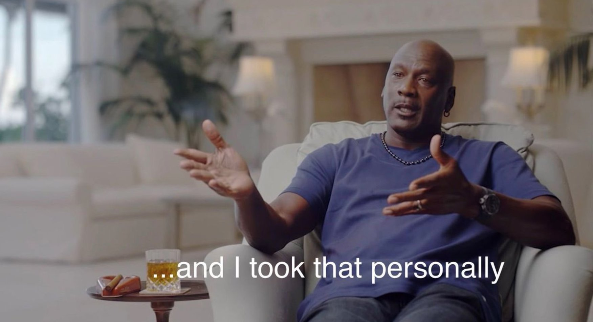
FrankMcG.com
@FrankMcG
LinkedIn.com/in/FrankMcGovern
Notes:
MJ was known for taking things personally. Don’t, but do. Don’t let it slow you down, let it fuel your quality.

Slide 18
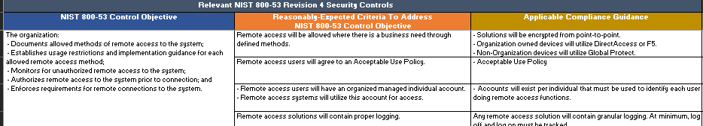
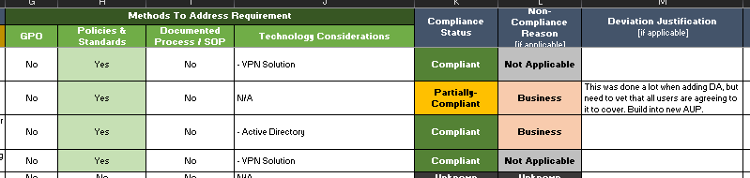
Compliance Tracking
FrankMcG.com
@FrankMcG
LinkedIn.com/in/FrankMcGovern
Notes:
Value of reporting and metrics.

Slide 19
Writing Cybersecurity Policies: You Don't Have to be Michael Jordan
Frank McGovern
FrankMcG.com
@FrankMcG
LinkedIn.com/in/FrankMcGovern
Notes:
GitHub Uploaded - Tweet

